Slide 1


CloudAscent
Propensity model leveraging transactional customer data for SMB partners
How to download propensity insights for transactional customers in Partner Center
What is CloudAscent and what data surfaces in the download?

Slide 2
What is CloudAscent

Slide 3

Grow your business with a deeper understanding of existing customers
Customer opportunity impact
Focus high-cost sales resources on the customers with highest propensity to buy
Identify when customers are ready to move to a second workload
Develop micro-targeted marketing campaigns to address customers’ unique needs
Reduce customer churn
Notes:
Its main objective is to grow your business with a deeper understanding of your existing customers.
Focus high-cost sales resources on the customers with highest propensity to buy
Develop micro targeted marketing campaigns to address customers’ unique needs
Identify when customers are ready to move to a second workload
Reduce customer churn

Slide 4
SMB customer landscape
152M SMBs
Upper Medium
Upper
Medium
350k Enterprise look-alikes in-house IT
Org Size 300+
ACR Web Direct > $1000+ per month
Medium business
Medium
business
6.4M accounts
Avg. employees: 25 - 300
In-house IT or partner-led IT
Small business
Very Small business
72M accounts
Avg. employees: <25
No IT
Notes:
Cloud Ascent is a data engine focused on the SMB customer opportunity. There are about 78M SMBs globally, we break down the SMB segmentation into these buckets. For Top Unmanaged, we have both User Based and Compute Based. For user based, this will be for seat-based products, Office 365 or D365, where the customer has 300+ employees. Top Unmanaged Compute Based is going to be Azure focused where the customer has 1

Slide 5
AI & ML driven predictive models
Browsing patterns & content consumption
Social engagement
Buyer
Intent
Behavior elements
Browsing patterns
Job postings
Blogs
Skills Profiles
Content downloads
Conferences
Social Engagement
Solution categories
Cloud productivity
Cloud platform
CRM
ERP
Mobile device mgmt. and security
Database–BI/Analytics, data modernization
Voice
Buyer
Intent
Win/Loss MS sales & CRM data
Firmographics & technology install
Sales elements
Sales historical revenues/products, sales opportunities
Win/Loss factors
Products owned, activated, consumed
100+ additional variables
External firmographics
Company size
# of employees
Recent funding events
Hiring
Install Data
3rd party technology profile data racking of 3,000+ technologies/installed bases publicly accessible data
Account Fit
Elements
Account Fit
Elements
Notes:
Our Cloud Ascent data engine is driven by Machine Learning models. Each of the cloud products has their own CloudAscent model. And each model has two elements – the account fit score and the buyer intent score – and both of those are comprised of the analysis of hundreds of signals and inputs.
Specifically with the account fit score, we are looking at the top SMB customers and looking at the sales elements that make them top customers. – historical revenue and sales opportunities, any win/loss information, and other MS sales data. We also take a look at the customer’s domain to get demographic information – company size, # of employees, install data.
On top of the account fit score, we layer the buyer intent - this includes signals of their online behavior. Are they blogging? Are they doing anything online that might indicate they will purchase Microsoft products soon. This can also include job postings,, conferences, social engagement, browsing patterns – are they looking at specific products or services.
All of our intent models are updated on a monthly basis and the fit models are updated on a quarterly basis.
We layer on top of the account fit, the buyer intent

Slide 6
CloudAscent propensity how to leverage
Act now Sales ready customers-target with outbound tele | Sales Team Call to action to map into local CRM and engage if its not on the current pipeline
Evaluate Marketing ready customers-target with multi-channel marketing | Marketing Team Target with paid campaigns-Send materials to download and learn more
Nurture Target with awareness campaigns | Marketing Team Organic marketing campaigns, videos and infographics
Educate Monitoring for intent and customer fit changes
Intent signals
High
Med
Low
Very Low
Act now
High
Evaluate
Med
Account fit
Nurture
Low
Educate
Very Low
Notes:
What we recommend for the Act Now cluster is a targeting campaign with your outbound tele sales reps for a 1:1 conversation. These customers again have a high account fit score so they have the sales and CRM data and the firmographics of a top SMB customer. I suggest aligning this data with the SQL/MQL models used internally for it to be actionable for you.
Slightly below the Act Now category, is the Evaluate cluster. This is a group of customers that have a medium account fit score and again can have varying Buyer Intent Scores. If you have the capacity and bandwidth, it would be great to also include this group in the high touch call down with the Act Now group. If not, I recommend a paid targeted campaign to continue to qualify them
With Nurture and Educate clusters, I recommend more nurture or awareness campaigns done organically. They may not have the full awareness of how your Microsoft solutions can help full a gap in their business so there will be more information you will have to share with them.

Slide 7
CloudAscent propensity models
Social | Public events | Win/Loss
Job postings | Blogs | Content consumption
Browsing patterns | Install data | Sales performance
Technology install | Product usage | Company size
Grow your business by tapping into your current customer base by leveraging customer opportunity reports powered by Cloud Ascent
Machine learning models calculate account fit and buyer intent scores based on hundreds of signals
Buyer intent models are updated monthly and account fit models are updated quarterly for refreshed reports every month
Scores are ranked into high, medium, low, and very low across both account fit and buyer intent
These scores are then clustered to represent the customer propensity Act Now, Evaluate, Nurture, and Educate for your current customer base
Intent signals
High
Med
Low
Very Low
Act now
High
Evaluate
Med
Account fit
Nurture
Low
Educate
Very Low
Notes:
We funnel all that information through the machine learning models and get their account fit and buyer intent scores. These scores are ranked into high, medium, low, and very low buckets and then clustered into four categories: Act Now, Evaluate, Nurture, and Educate.
As long as a customer meets the account fit score of high, it will be clustered into the Act Now category even if it has a low buyer intent score.

Slide 8
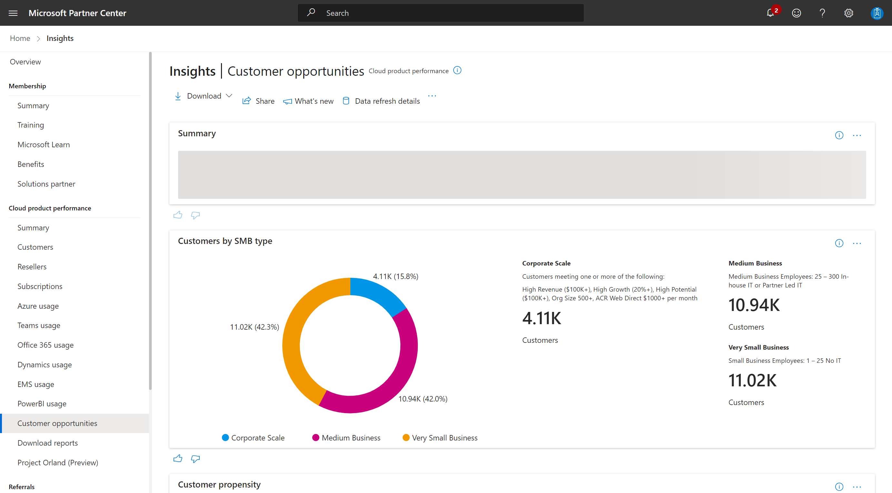
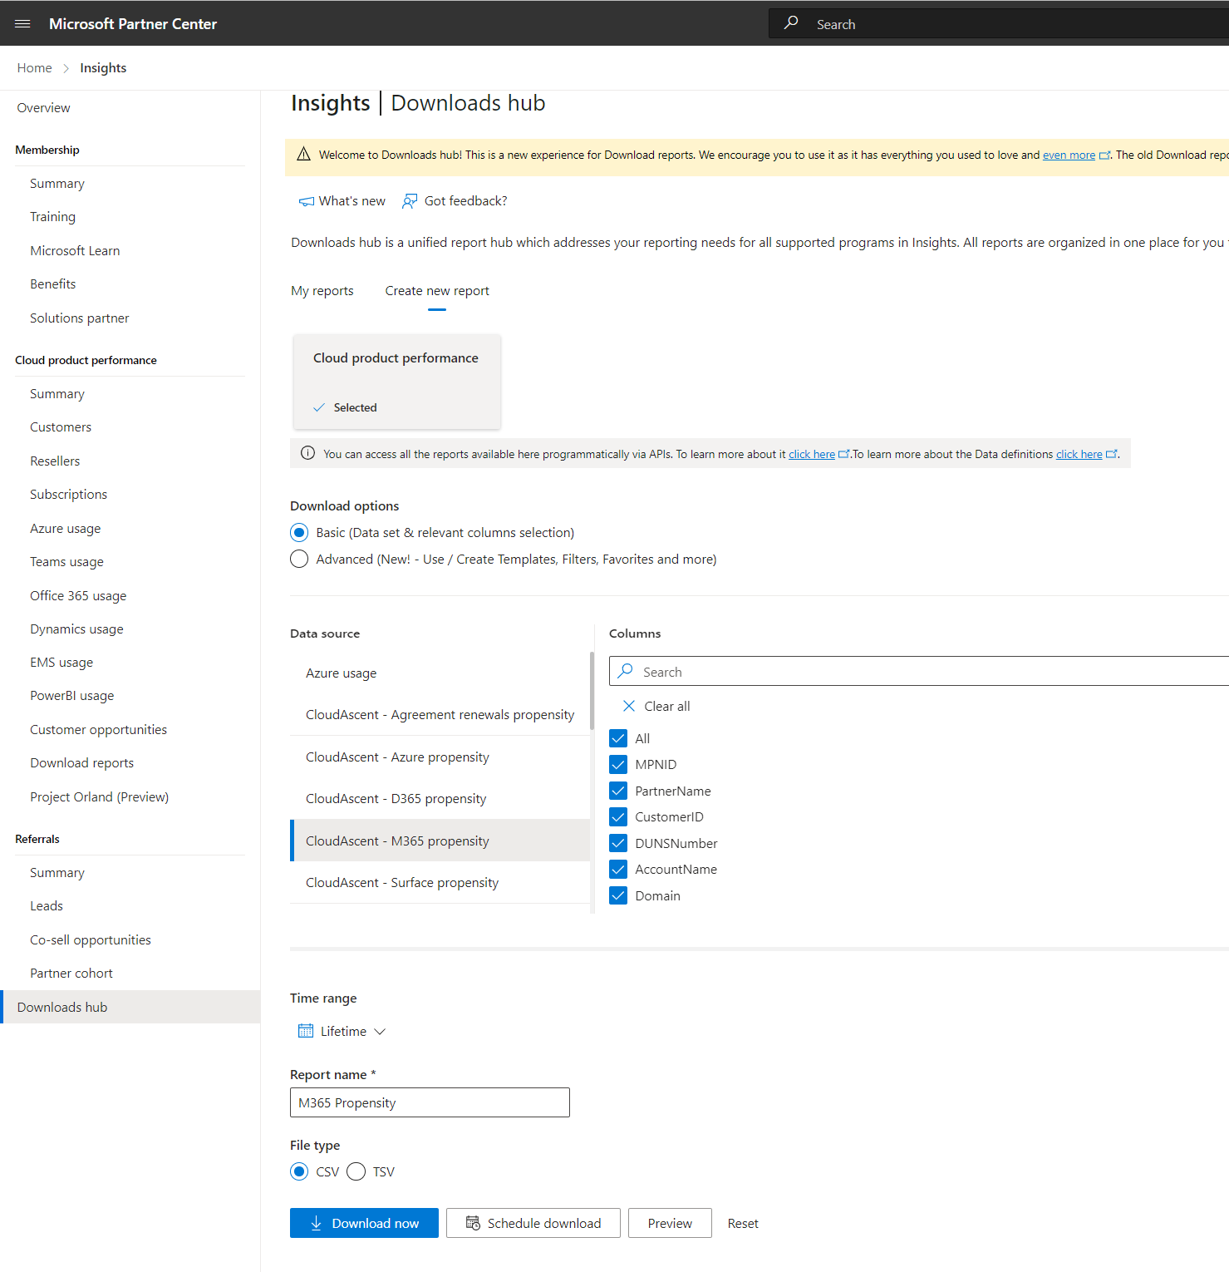


CloudAscent Partner Center Downloads
CloudAscent Data in partner center is available in two locations: Customer opportunities with a summary view for partners; Detailed downloads available via Downloads Hub tab.
Customer Opportunities
Downloads Hub

Slide 9
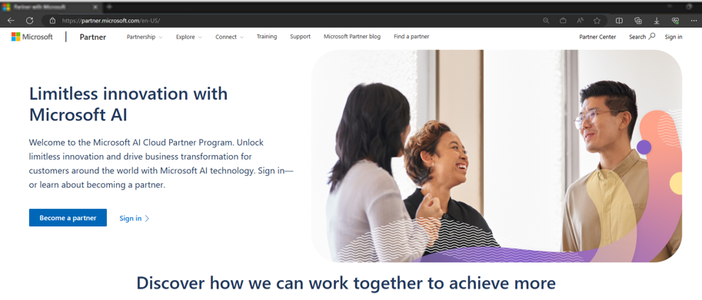
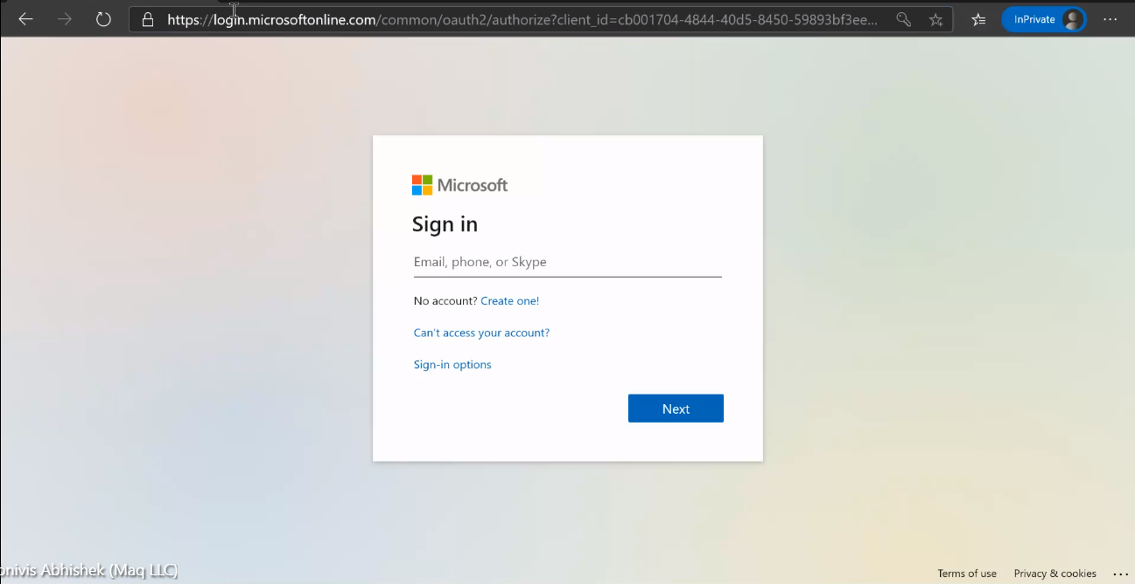
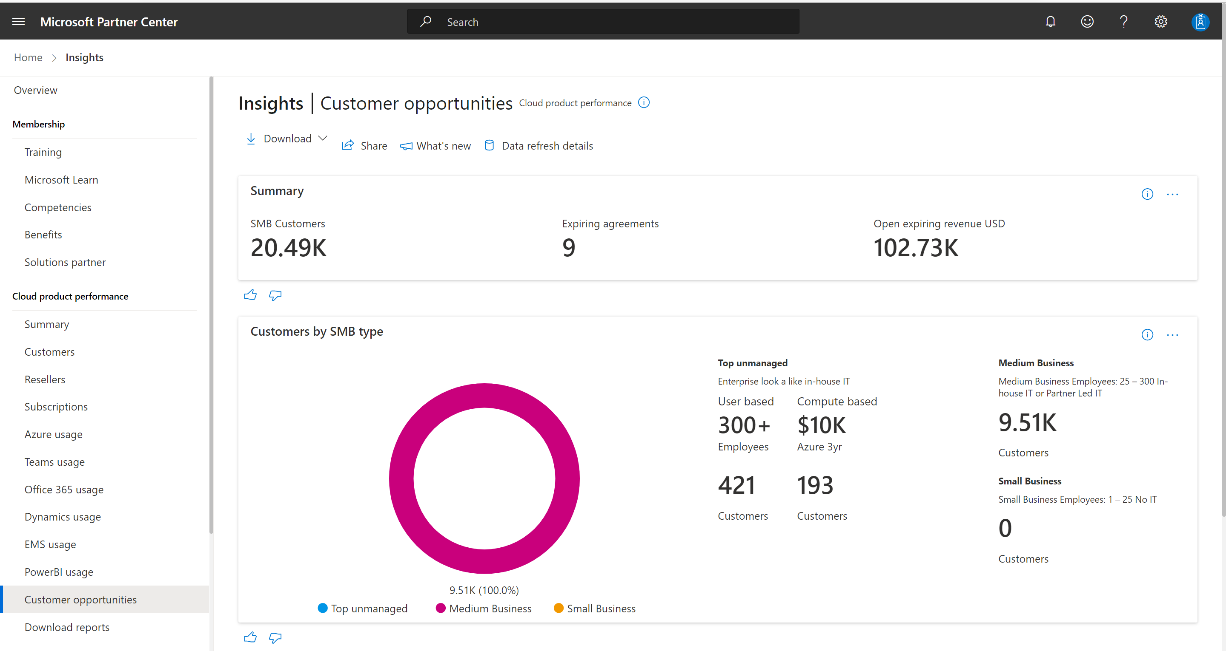
Accessing through partner center
1
1
Navigate to https://partner.microsoft.com/ & select Partner Center.
2
Sign in using your company email.
2
3
Once logged in, navigate to the customer opportunities tab in the Insights workspace.
3
Notes:
CloudAscent surfaces transacting SMB customer data for partners to download from Partner Center. These steps provide a description of how to access propensity data for your transactional customers.

Slide 10
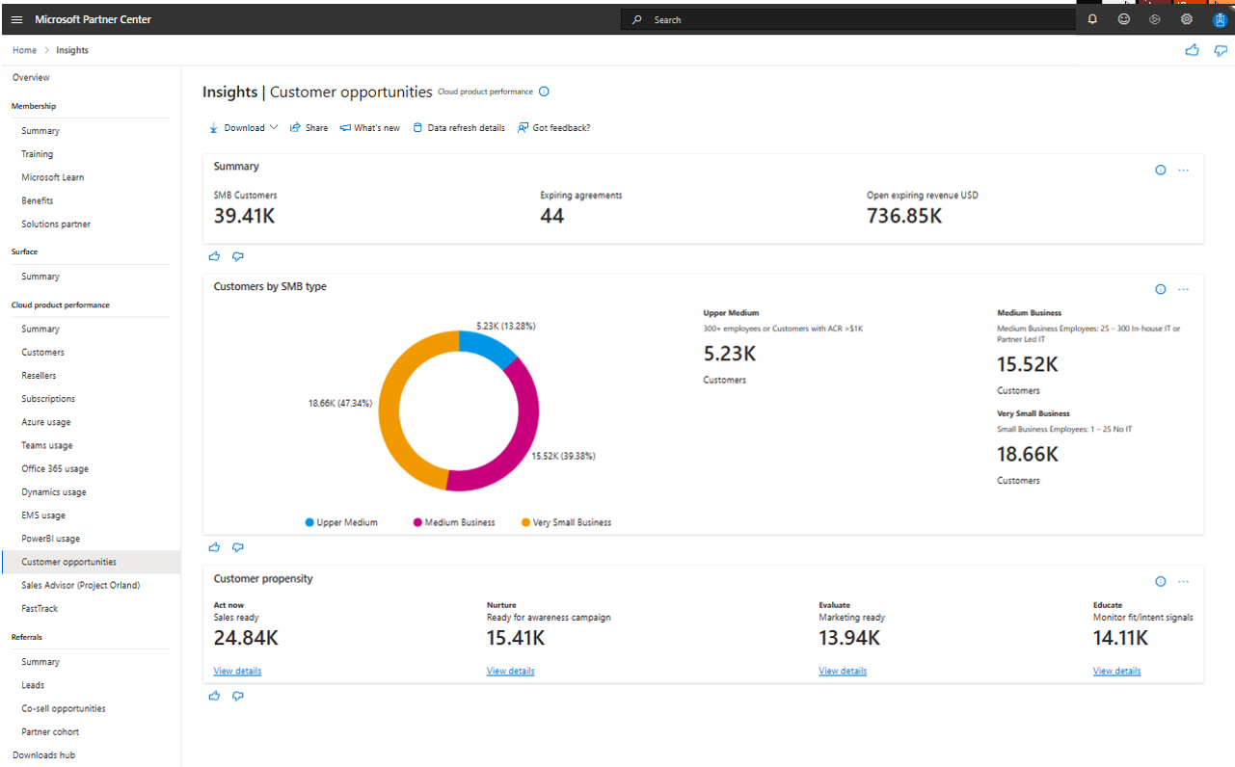
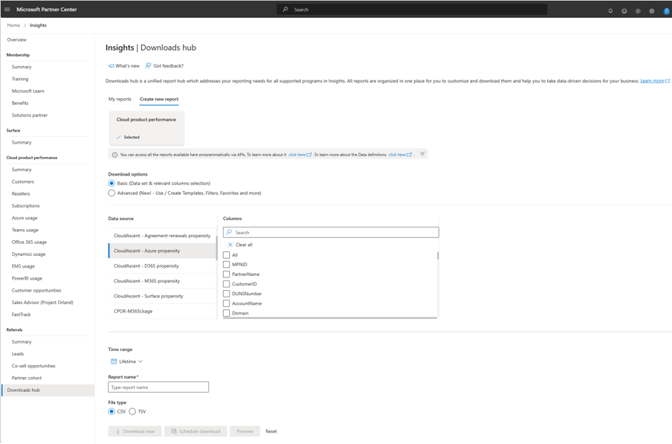
Getting started
4
To download the report insights into Excel, Select the Downloads Hub in the left-hand navigation.
4
5
Within the Downloads Hub, Create a new report, ensure you have Cloud product performance selected and have chosen the Basic Download option.
Under Data Source, you can select any of the 5 CloudAscent Propensity data reports identified by the “CloudAscent–Title” (M365, D365, Azure, Surface, Renewals).
To download select the columns to include in your report, add a report name, select CSV file type and Download now.
5
Notes:
You’ll need to download D365, M365, Azure, and renewals individually to see product propensity recommendations and sales plays for your customers.
selecting the download from the Customer Opportunities tab,

Slide 11
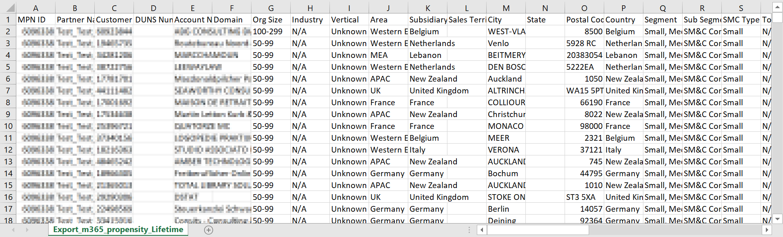
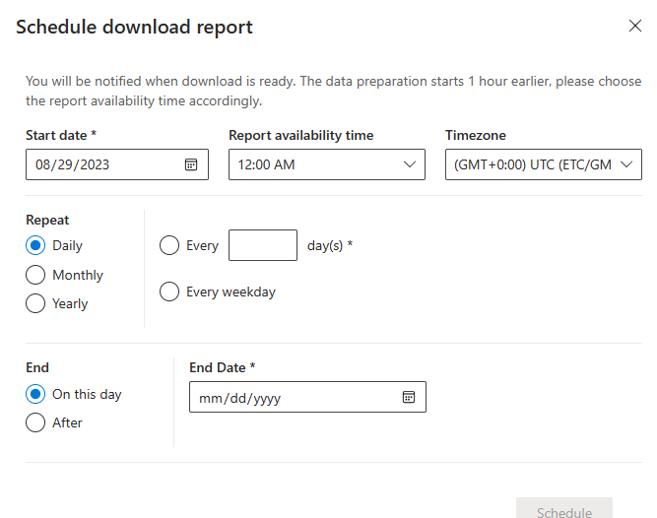
Propensity reports
6
Once open, each file starts with your own Partner ID/Name, followed by your customer firmographics data, and propensity recommendations.
Target the act now and evaluate propensity clusters for the highest yield customers.
6
7
Set up to receive reports on a recurring bases.
7
Notes:
Your customers will be scored for all products including those they own. For Azure and O365, upsell propensity is also provided look for the Azure Upsell/O365 Upsell columns.

Slide 12
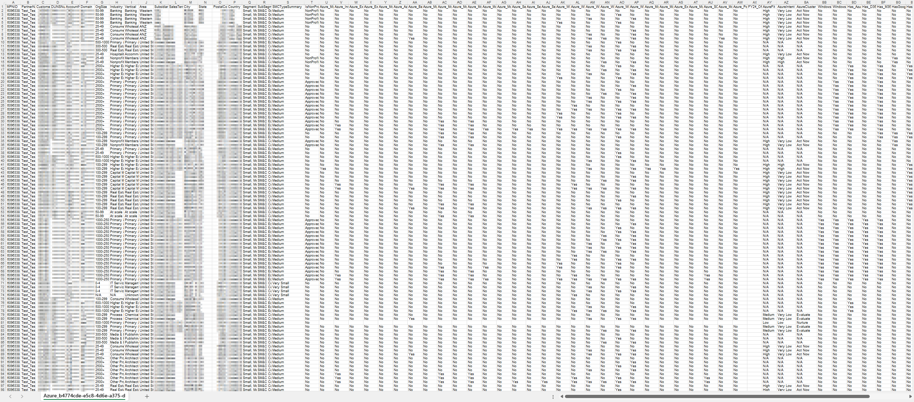
Download Highlights
3
Solution Plays: yes/no indicator to determine if the customer is part of the Solution Play. Use Microsoft Learn to get the targeting details
1
Key Customer Firmographic Attributes: Customer Name, Domain, Duns Number, Org Size, City, State, Postal Code, Industry, Vertical, Segment, Sub Segment
4
Propensity:
M365 – M365, Surface, and M365 upsell potential
D365 - D365 Finance & Operations, D365 Business Essentials, D365 Sales Pro, and Power Apps
Azure – Azure, & Azure next logical workload
2
SMC Type Summary: Customer Segmentation into Upper Medium, Medium, and Very Small Business to define customer size and potential
1
2
3
4

Slide 13
FY24 Solution Plays
Modern Work
Secure Productivity
Converged Comms
Modernize with Surface
Azure
Accelerate Developer Productivity
Build Intelligent Apps
Innovate with AI
Innovate with HPC, AI Infrastructure
Migrate & Secure Windows Server & SQL Server
Migrate Linux Estate
Migrate Oracle
Migrate SAP
Migrate to Azure Analytics
Modernize Enterprise Applications
Power Business Decisions with Cloud Scales Analytics
Dynamics
Maximize Sales Impact
Simplify Business Process
Transform Business Operations

Slide 14
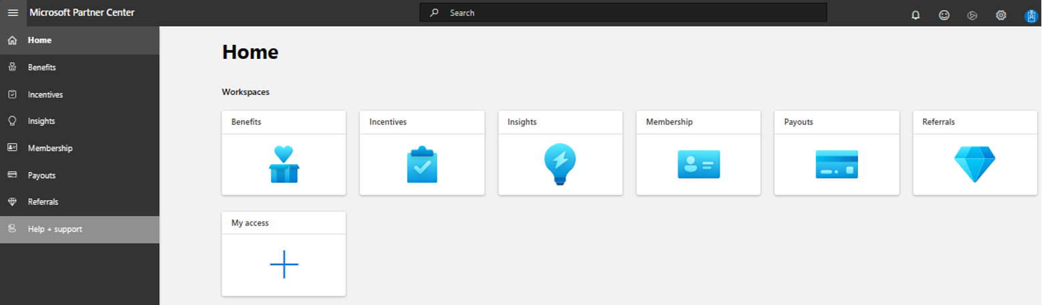
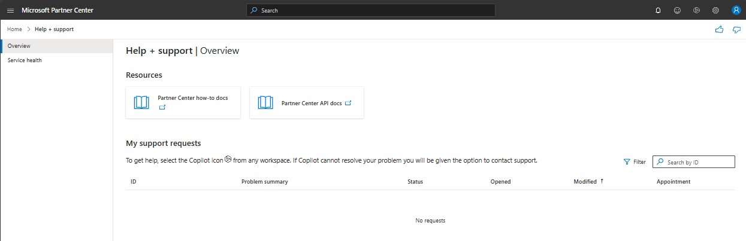
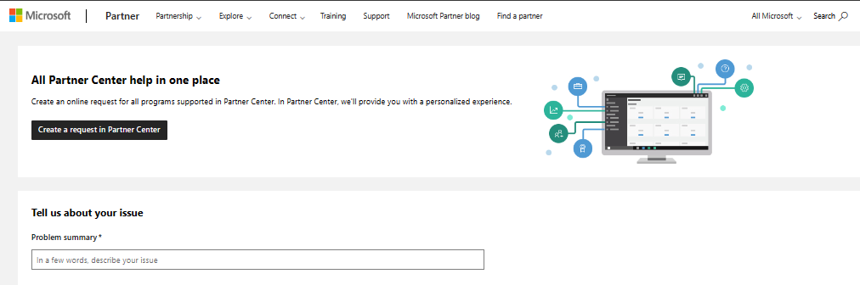
Support for accessing partner center
If you are having challenges accessing CloudAscent, please create a Support ticket.
A
A
Within Partner Center, in the top-left menu, select Help + support.
B
Explore Partner Center How-to docs or API for self-serve help. For help within a Workspace, select the Copilot icon to contact support.
B
C
Outside of partner center, navigate to the support tab on Partner.Microsoft.com and select create request in Partner Center or fill out the information requested for self-serve help.
C

Slide 15
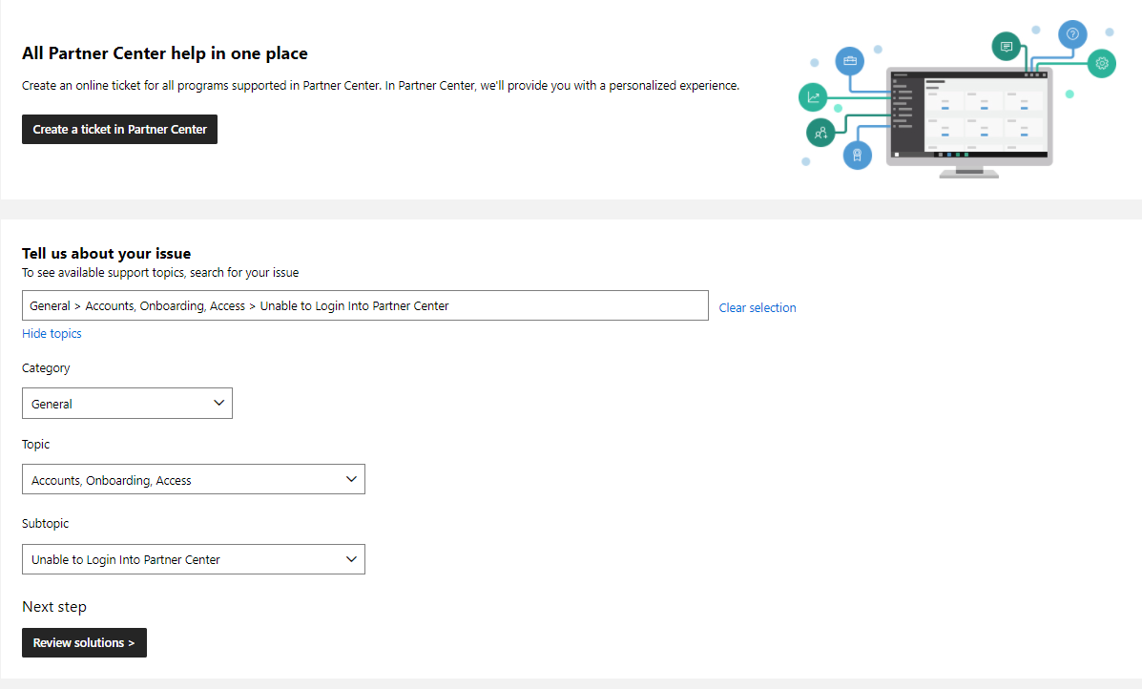
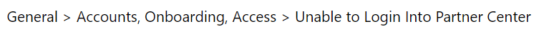
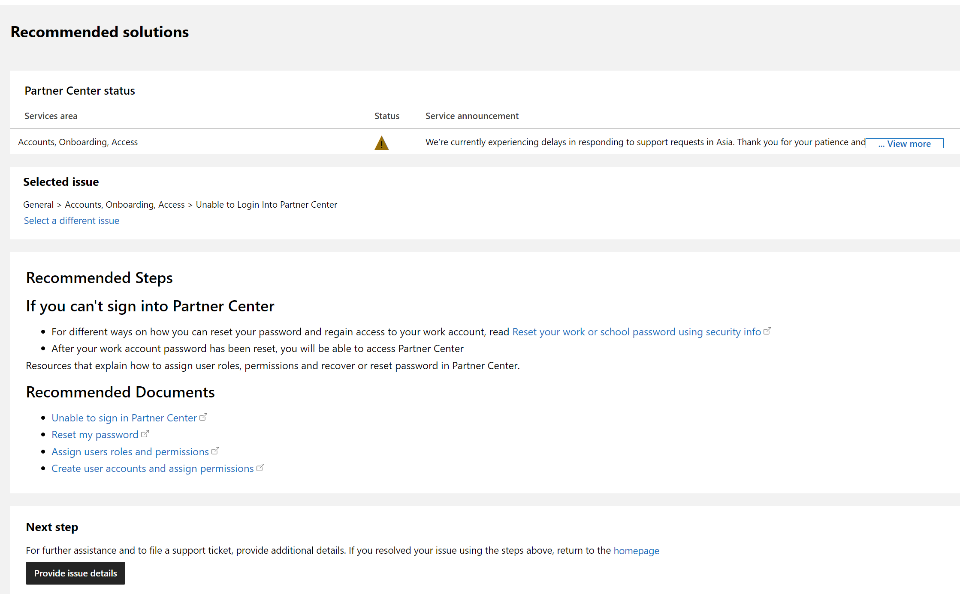
Support for accessing partner center
If you are not able to login to Partner Center, here is how to create a Support ticket.
A
A
Select unable to login into partner center by browsing through topics as shown and review resolutions.
B
If the recommended solutions do not resolve your issue, submit a ticket by selecting Provide issue details.
B

Slide 16
GTM Resources

Slide 17

Marketing Resources
Microsoft AI Cloud Partner Program members can access self-serve resources to help build a strong marketing and sales motion.
Get started on your marketing journey with the below self-serve marketing resources.
Smart Partner Marketing
Digital Marketing Content OnDemand
Partner Marketing Center
Partner GTM Toolbox
Training to skill-up your marketing team, including industry trends, market research, and best practices. Get started.
Customizable 10-week social media and email campaign content to generate leads for your business. Get started.
Digital content library for solution-specific marketing, sales, and readiness materials including customer pitch decks, pre-written emails, and marketing assets. Get started.
Co-branded asset templates for you to customize specific for your industry and solution including customer pitch decks, pre-written emails, and marketing assets. Get started.

Slide 18

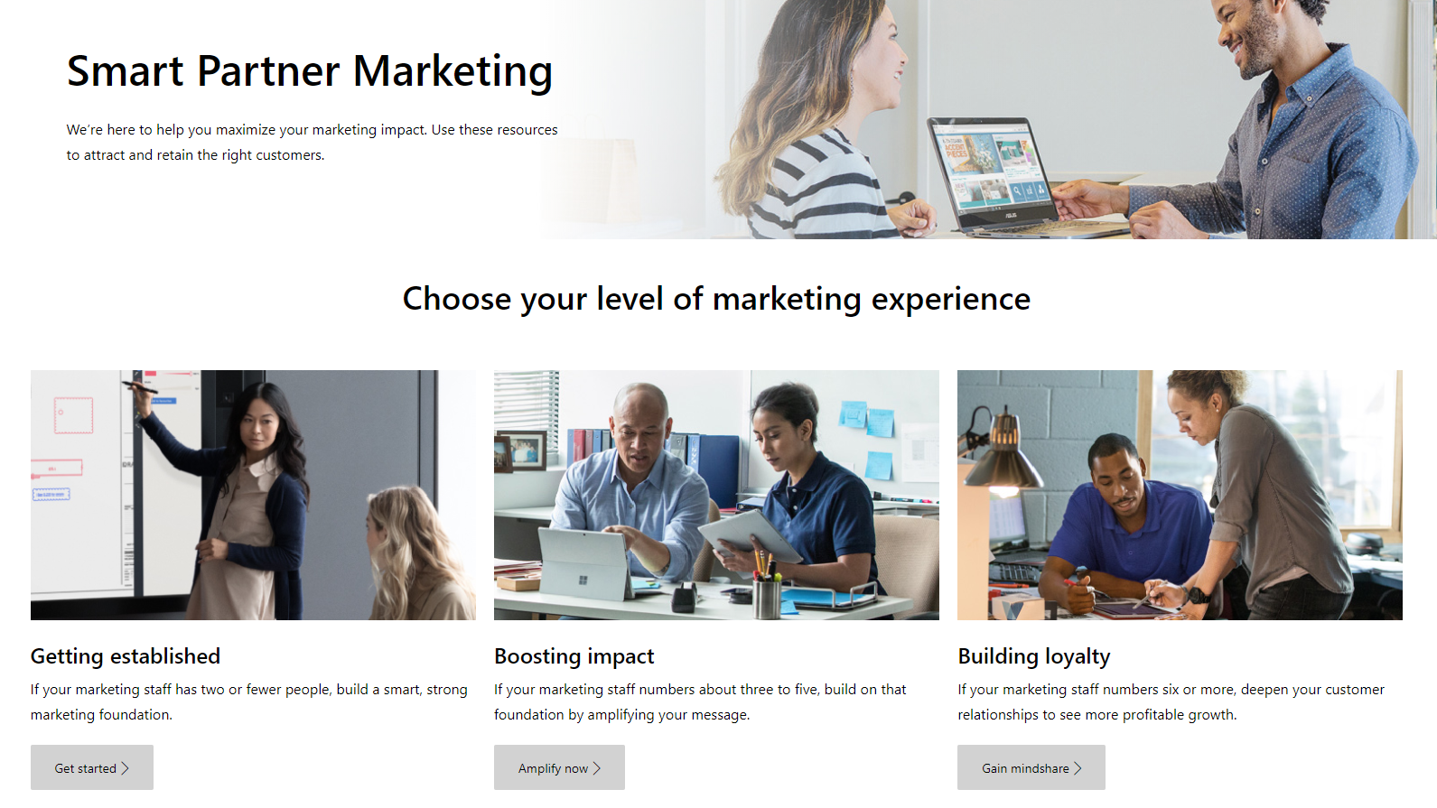
Smart Partner Marketing with Microsoft
Maximize your marketing impact.
Whether your marketing team is just getting established, is growing and boosting performance, or building loyalty among established customers, Smart Partner Marketing training can help your team hit their marks.
What is included:
OnDemand training to skill-up your marketing team, including top-tier industry trends, market research, and best practices.
Business impact:
Grow your marketing impact, test your digital marketing channels, get actionable advice, and tutorials to help you improve.
Microsoft AI Cloud Partner Program members
GET STARTED https://aka.ms/smartmarketing
8

Slide 19
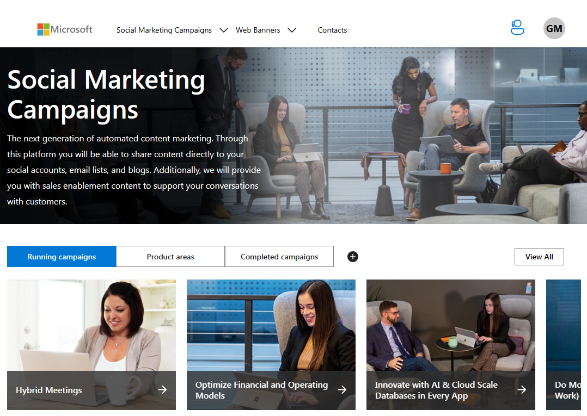
Digital Marketing Content OnDemand
Increase productivity and generate demand online.
Digital Marketing Content OnDemand is your own personal digital marketing assistant and delivers fresh, relevant content for you to customize and share on your social, email, website, or blog.
What is included:
10-week digital campaigns that include to-customer content and to-partner resources.
Business impact:
Gather leads directly from your social media accounts, push content to your company’s social media accounts without any action from you, and leverage the pre-created emails, social posts, and other great content available.
Microsoft AI Cloud Partner Program members
GET STARTED https://aka.ms/DMC
7

Slide 20
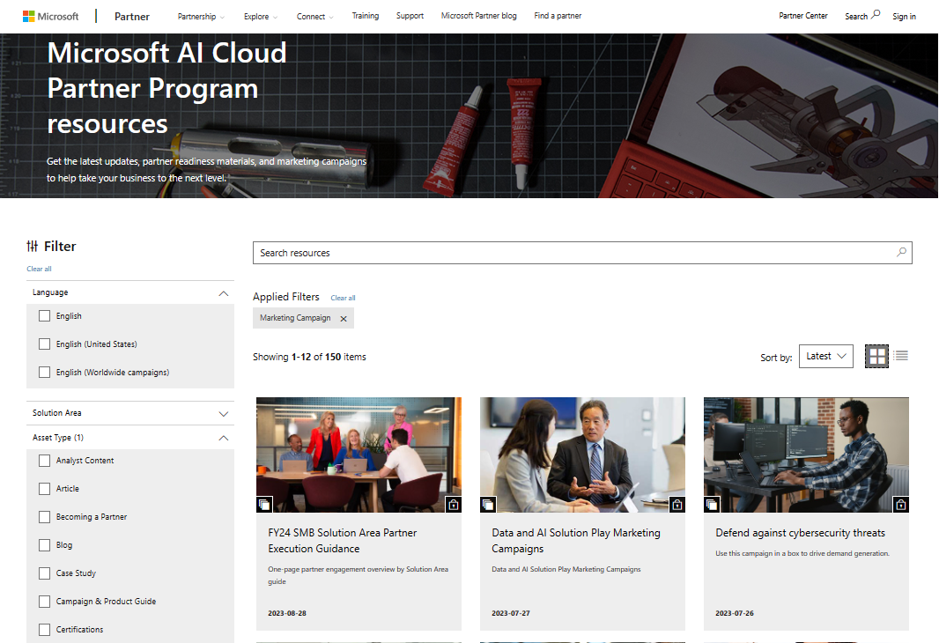
Partner Marketing Center
Get the assets you need for your customer conversations
Digital content library for solution-specific marketing, sales, and readiness materials including customer pitch decks, pre-written emails, and marketing assets.
What is included:
Assets including one-pager, presentations, playbooks, and guides.
Business impact:
Check out the go-to-market gallery for more easy-to-use, co-branded assets. Plus, browse topics on planning, strategizing, and executing your go-to-market campaign.
Microsoft AI Cloud Partner Program members
GET STARTED https://aka.ms/PMC
7

Slide 21
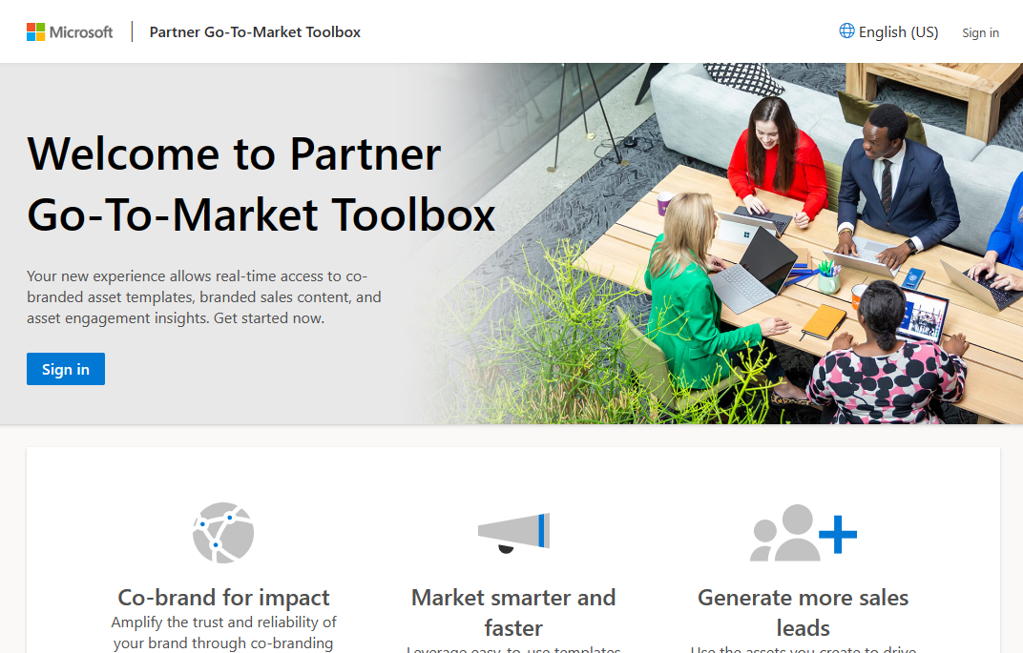
Partner Go-To-Market Toolbox
Amplify the trust and reliability of your brand through co-branding with Microsoft. Partners who want to bring their solutions to market faster and connect with more customers can find the support they need to effectively co-market with Microsoft in Partner Go-To-Market Toolbox.
What is included:
Fully customizable co-branded assets aligned with solution areas.
Business impact:
Drive awareness and demand of your solution.
Microsoft AI Cloud Partner Program Solution Partner Designations
GET STARTED https://aka.ms/GTMToolbox
19

